Slide 1



DATA EXPRESS
Jui Nagarkar, Becky Lin, and Yuying Li

Slide 2
WHAT IS DATA EXPRESS?
Data Express is a convenient team collaboration website that allows teams to work efficiently. Once a user signs into their account by EITHER logging in or creating a new account, the user can either create a new team or join an existing team. Within a team the user can create and view posts. Additionally, The user can also view their own profile which includes their username, email, and the teams that they are a part of.

Slide 3

WHAT WE USED:
HTML/CSS
MySQL
PHP

Slide 4
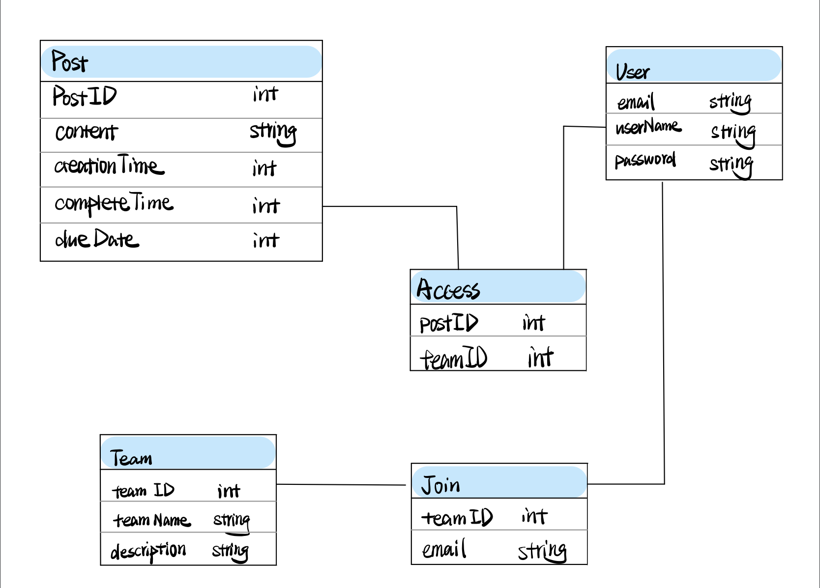
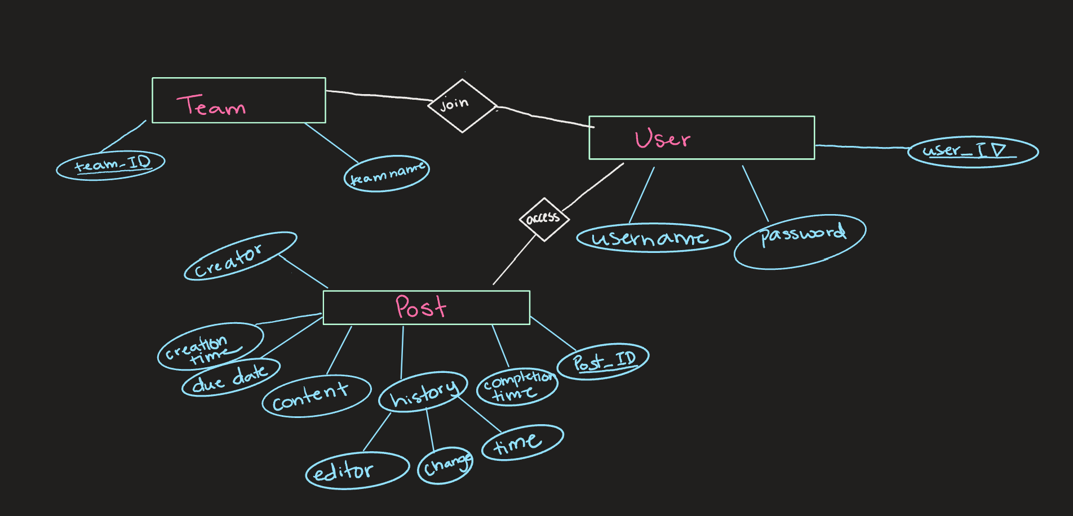
OUR MINI WORLD:

Slide 5
OUR LOGICAL DESIGN:
Team(team_ID, teamName) Join(team_ID,email) User(email, username, password) Access(post_ID, user_ID) Post(post_ID, content, creationTime, history_Editor, history_editTime, history_change, completionTime, dueDate, creator)

Slide 6

DEMO TIME!
https://people.eecs.ku.edu/~b884l228/

Slide 7
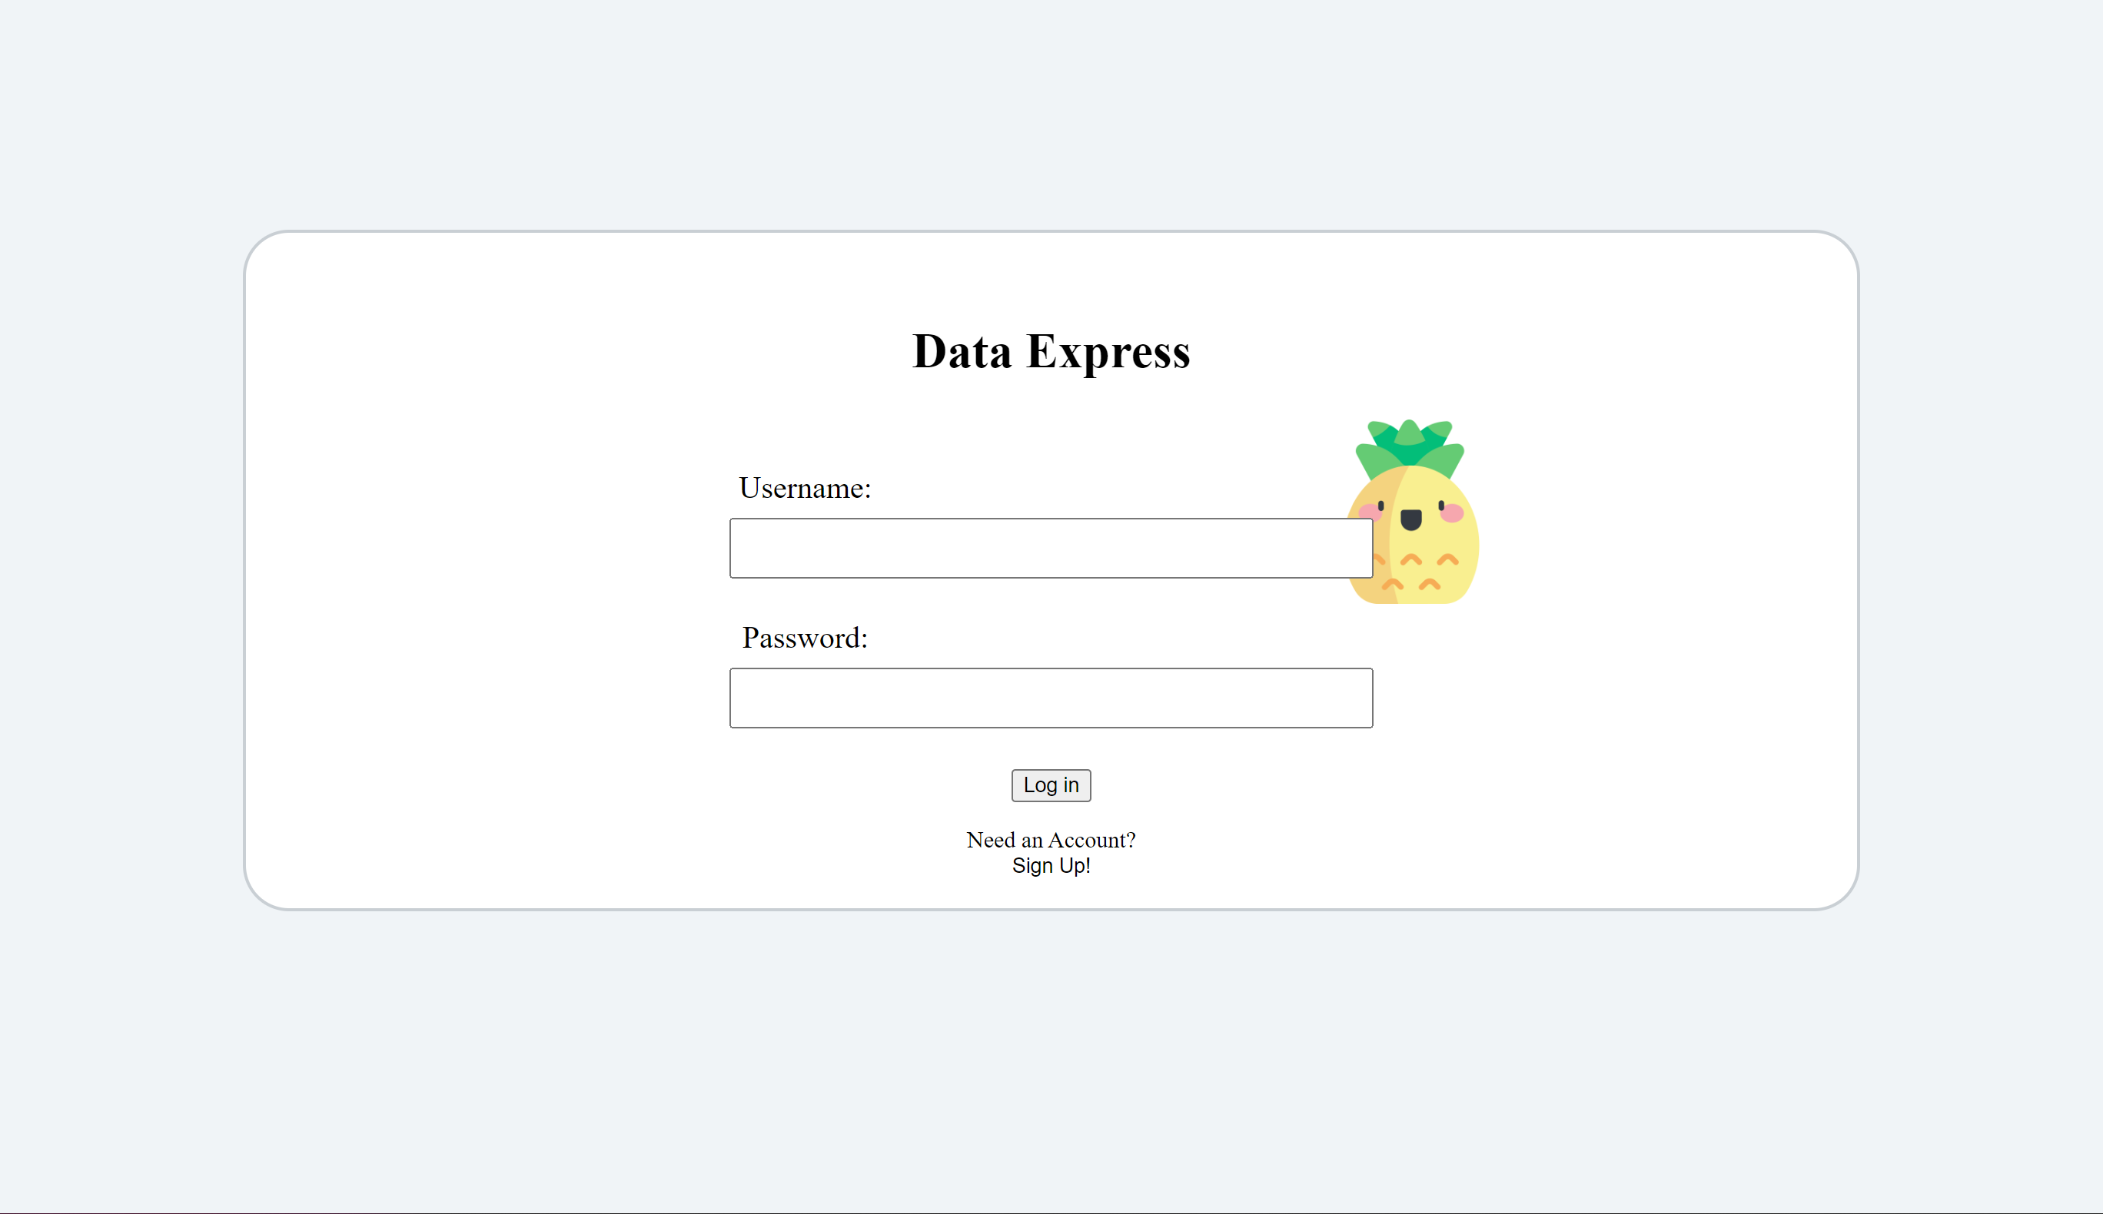
Summary:
Team collaboration for any small or big project requires proper communication. Data Express is one such tool that will allow users to enjoy their team-work experience. With all the features seen in the demo collaboration will become simpler and more efficient.

Slide 8

THANK YOU!
We hope you enjoyed our presentation and find Data Express useful in your future team collaboration projects!

